Slide 1
Notes:
Introduction- Dr. David Keller: So, hi, everyone. Welcome to the Friday Afternoon Seminar Series of the Department of Biological Sciences. Today we're very happy to have Dr. Tracey Goldstein from U.C. Davis, where she is a wildlife molecular epidemiologist. So if you don't know what that is, this is the perfect place to be because you will find out. And she is the head of a program, or part of a program, called PREDICT. She's the one of the coordinators for a new Viral Emergence Early Warning Project which is called PREDICT. And its goal is to aid governments in order to predict where new emerging pandemic infections might crop up, using epidemiology, using molecular tools. And her background is in marine biology, so she studied the marine mammals, and so she's part of the organizing there at U.C. Davis, part of the Wildlife Health Center at U.C. Davis. So, she'll be talking about her work. So, welcome.
Biological Science
PREDICT

Slide 2
Notes:
Dr. Tracey Goldstein: Thank you all for coming. Yes, so as David was saying, we are, I think, very fortunate to be a part of a program, called PREDICT, which is part of the Emerging Pandemic Threats Program that is funded by the U.S. Agency for International Development. And this project actually came out of the work that they've been doing with avian influenza when first H1N1 and the H5N1 spread around the world. They got involved in sort of working with a lot of labs and ministries and they realized that there was really nobody that was working on the wildlife side of things. And hopefully by the end of this talk I'll convince you about why it's important that we're working on wildlife. But what we realized was there was people that were doing human surveillance and domestic animal surveillance, but nobody with wildlife. So they put out this call and it's the first time actually a government organization like this actually funded a university-type organization to do this type of work. So it's very exciting and we hope that we've change their mind about why universities can do damn good work like this. And the charge that they put in front of us was to prevent or mitigate that next pandemic, from -- and wildlife before it jumps into humans, so obviously a pretty big charge. And the way we work is U.C. Davis is the lead of this project but we have partners across the country that belong to organizations like Wildlife Conservation Society, EcoHealth Alliance, the Smithsonian Institute, and also a company called Metabiota which is in San Francisco. So we're a combination of nonprofit organizations and university organizations, so it's quite exciting. And we also have teams, as you'll see shortly, in 20 countries around the world. And it's those teams around the world that actually doing the work and implementing the job of the project.
Biological Science
PREDICT

Slide 3
Notes:
So why is this even important? I think everybody's really aware, especially in places like the tropics, there's huge amount of land use change that's occurring, deforestation, climate variability. I think this year is a really good example. Some of you might be aware of this unusual mortality event along the coast in California sea lions; and they think that that may be due to prey changing, maybe potentially due to climate change and/or change in sea surface temperature. Of course, these days, markets and trade -- things can get sent around the world very quickly. Many of us get our pineapples from Chile, and who knows how those came across to California. Of course, migration and conflict -- we work in places like Rwanda where at -- for many -- a few years back there was a really severe civil war in the country, which drove people from the cities into the forests where they felt more protected. And then, of course, that changes the dynamics of who they're coming in contact with. Resource extraction -- I'll show you a photo in a little while -- that in Tanzania the Great Ruaha River is a huge river that used to support the whole area. And then through damming, now there are certain times of the year where almost no water flows, bringing people and animals really closely together. And then, of course, water and food security, that's something that everybody's constantly worried about, moving the pathogens across borders. And then, probably one of biggest things is global transportation. I don't know if any of you saw that movie “Contagion,” but there was a little image in there that showed you how quickly planes are moving around the world and it's so easy these days. I was just recently in Katmandu, and within a few hours I was in Hong Kong, and from there I was back in San Francisco. So it's amazing how quickly things can now move around the world.
Biological Science
PREDICT

Slide 4
Notes:
So, as I said, our challenge is to preempt and combat, at the source, these emerging pathogens – emerging zoonotic diseases that may pose a significant threat to public health. So really, it's interesting because we're wildlife epidemiologists and veterinarians. But we’re working on a public health project. This really is to affect public health. Although we care about conservation of animals, our goal here for this project is a little bit different than the type of work we usually do.
Biological Science
PREDICT

Slide 5
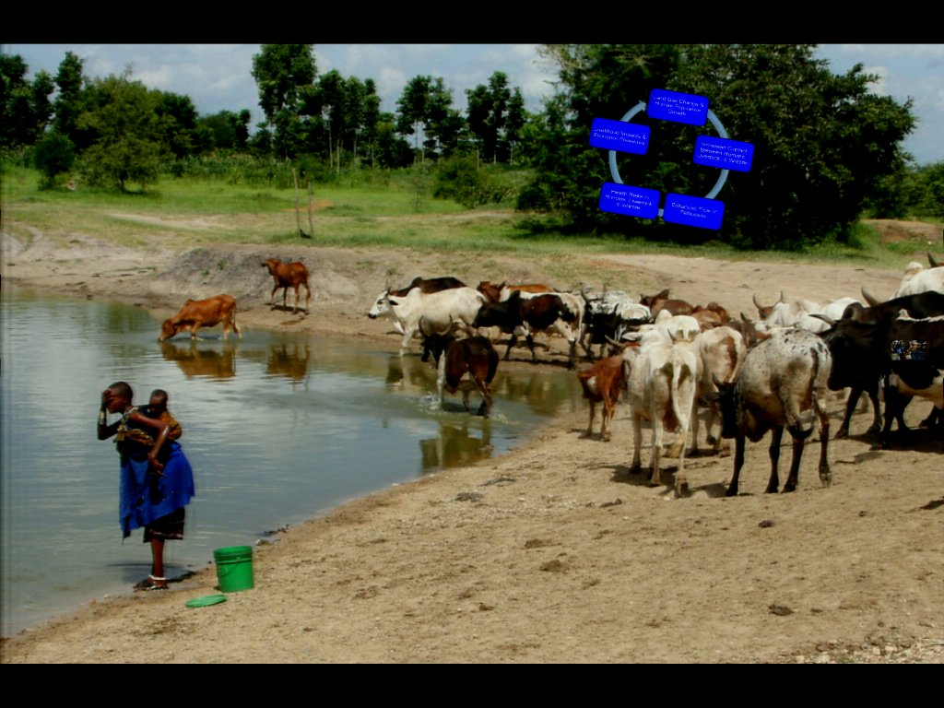
Notes:
And this is an example of what I was talking about. This is a place in Tanzania where during certain times of the year there is really limited water resources. And so what you see here is this lady's coming down collecting water that she's taking home, that she's going to use to cook her dinner and do her dishes. She's also bathing herself and her baby, and she also brought her cattle down with her at this -- to the same location to get their water. But what you can't see, and if you were here earlier on in the day, if I was able to zoom into that photos, there's actually footprints of wildlife who were there drinking water earlier in the day. So this allows that -- sort of really reminds you there's this area where -- at this moment you might not realize it, but with the sharing of this water resources, there's a lot of opportunity for contact among different species and people.
Biological Science
PREDICT

Slide 6
Notes:
And some of you may know this, but the majority of emerging infectious diseases come from animals. So that means that they’re zoonotic. And even more stunning is that 75% of these come from wildlife origins. So that's pretty amazing. And I don't know if everybody does always know that. And so when we think about what are these diseases, examples of them are things like Necro Virus from bats in Malaysia -- again, the virus all focus and then would be contagion; SARS -- I'm sure you guys are all familiar with that; Ebola; and then, of course, HIV. HIV came from chimpanzees in Africa and then amazingly spread around the world. And the other interesting thing is that people -- there's this huge annual population growth and what that's meaning is that people are sort of living outside in these buffer areas, these places that used to protect us, that used to separate wildlife and people. They're now living in those areas, and so they're bringing everybody in much closer contact than ever before. And in Africa and also in Asia, interestingly, the people live really, really closely with their animals. When I was just, like I said, in Katmandu, at night the goats and chickens and everybody comes into their houses with the people, often on the first floor. And if it's a small house, then it's on the same floors where everybody lives. So I think it's hard to realize how close in contact everybody is coming.
Biological Science
PREDICT

Slide 7
Notes:
And so again, you know, as I said, this land use change and human population growth is driving this increased contact between humans and livestock and wildlife, which then gives us bigger opportunity for pathogens to move among these different groups of people and animals. And so the risks to humans, and livestock, and wildlife is changing constantly depending on the type of contact that they're having. And then, of course, this always affects impacts on economic pressures and livelihood. Of course, no countries want to have to deal with the new disease that's jumping into their livestock and then having to cull a lot of animals. It has huge effects on economic pressures, so all of these things drive each other and led to why USAID really wanted to invest into this type of program.
Biological Science
PREDICT

Slide 8
Notes:
So this is a little bit of what I was talking about. In general, you know, wildlife, wild animals, have their own diseases, and often they don't make themselves sick, you know. We carry our own viruses that don't always make us sick. So with wildlife this is this very similar case. However, every once in a while a disease might spill over -- usually first it’s domestic animals. So wildlife come in really close contact, especially at the edges of national parks. So, for example, up in Rwanda, we have photos of gorillas coming out of the park and eating the crops -- the same places where the cows and chickens are hanging out. So, there's often a much higher opportunity for spillover to occur into domestic animals. And then every once in a while there might be spillover from domestic animals into humans. And this is the place that -- where we're hoping that we can have the most effect with our project and see if we can prevent that cycle from occurring.
Biological Science
PREDICT

Slide 9
Notes:
So this is sort of the current state, including in this country. People ask us a lot, why are we working in other countries when we have the same problem in this country? Which is a really good question. But this is sort of the -- the current state of outbreak protection detection and response. And often you get the first case -- so where the first arrow was. I don't know if this works. No. I don't know. So that -- there we go. So, often you see the first case, and given the -- depending on the system, you know, it might be seven to 10 days before somebody realizes there's sick people. It takes a little while for somebody to realize that there's something going on. And then sometimes even longer -- maybe another 20 days -- before there's any type of lab confirmation. That's if a lab test is even available to detect what the pathogen may be. And then, finally, once you've got that confirmation of what the problem may be, then there's an opportunity for response which often is quite small.
Biological Science
PREDICT

Slide 10
Notes:
And so, with this program, we're hoping to sort of shift that whole system slightly where, if we can put in a surveillance and monitoring program early on, then potentially this timeline between the first case and actual detection is much shorter. And, if we can work with the labs to improve diagnostics, then that confirmation, again, is much shorter, which then allows for a much more larger opportunity for control.
Biological Science
PREDICT

Slide 11
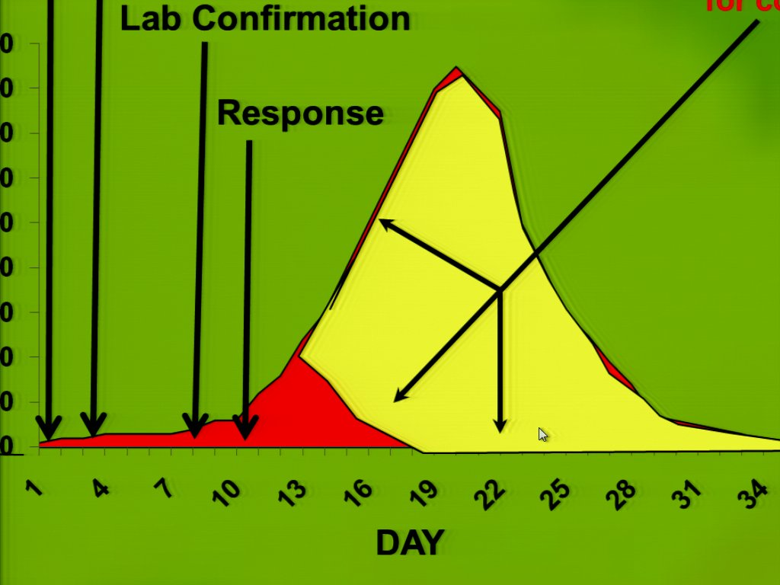
Notes:
And recently I was in a meeting in Bangkok and the World Bank gave some numbers out about how much money they think has been spent globally just to respond to things like H1N1 or H5N1. And we're talking in the eighties of hundreds of billions of dollars in control. So if there's something that we can do to prevent that earlier in the curve, we potentially will make all of this -- I don't know if it's more affordable, but definitely hopefully more successful.
Biological Science
PREDICT

Slide 12
Notes:
So, the idea behind PREDICT is we're using a combination of new technologies to try to get out at the forefront of what's happening. First, we are doing a lot of digital surveillance, so we're working with companies like HealthMap and ProMED, and we're having -- we've -- through this project have been able to hire new people on the ground in Africa and in Asia, because having people on the ground reading newspapers and monitoring for a new event is one of the first ways to start to get this information into the global network. So we're doing that. We're also working with modelers that are looking at where pathogens came from before, what were the drivers that were affecting that and putting that into models so that we can help to predict where the next one may come from. And then, of course, field studies, which is what I'll talk about quite a lot today, which is the key, really key parts to this program where we're out there in the field working with both healthy wildlife, as well as, sick wildlife, collecting samples and getting them into the lab so that we can start to do some testing. And then with the laboratory investigations, that can hopefully start to retarget the information that goes into the models so that hopefully in the end we'll be able to predict better what is happening globally.
Biological Science
PREDICT

Slide 13
Notes:
So where are we working? We're working currently in about 20 countries and we're -- as you can see, they're sort of in the tropics. So we're in Latin America, Central Africa, Southeast Asia, and then Asia. And the reason we're in these parts of the world -- and in a little while you'll see another map that will also sort of highlight that. But you may be familiar with a paper by Kate Jones and others in 2008, and what they did was they looked at where emerging pathogens had come from previously. So they looked at what countries and sort of what areas they were coming from, as well as what species. And they summarized that together in a paper. And that was the starting point for USAID's idea of, you know, how to get started with this project and how to begin the funding. And we're in the process of actually reiterating and reworking that model because it was actually sort of driven by population -- sort of number of population in an area, as well as species biodiversity. And we know that there are definitely other factors that affect why diseases emerge; and so we're working to revisit that model and update the model with the information that we're collecting.
Biological Science
PREDICT

Slide 14
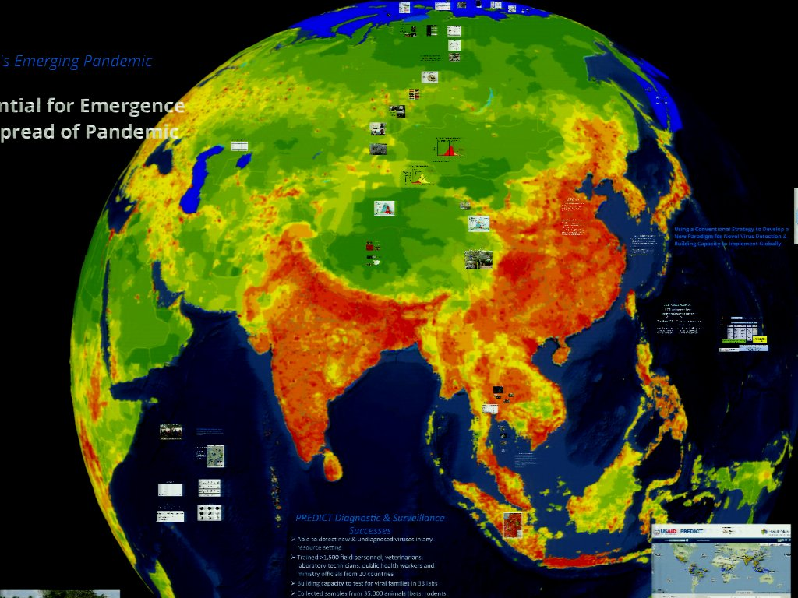
Notes:
So this is the model that I was talking about. And so, basically, what they did was they showed that areas that were red were places where there was a high possibility of emergence of a pathogen. And then areas in green -- well, based on the public information, right? So based on the literature, is places where diseases had not yet emerged. Now we do know that there is definitely problems with this in terms of reporting bias, as I mentioned. We're now putting people in Africa and Asia because we do obviously know diseases come from some of these countries. But there was no ability for their reporting to happen and for that information to get out. But this is sort of the premise and this is where the project started.
Biological Science
PREDICT

Slide 15
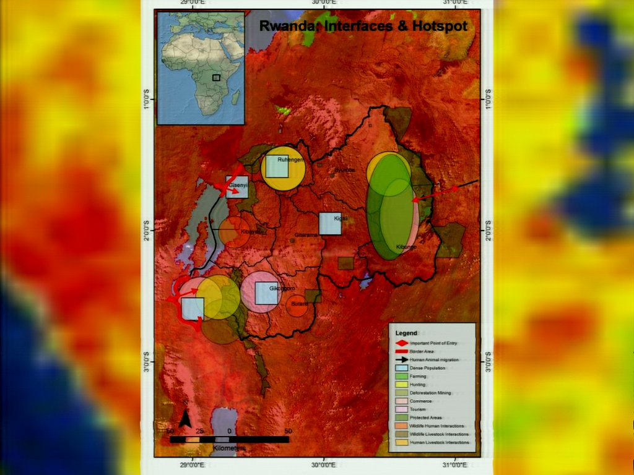
Notes:
And then we take that -- we took the information that the Kate Jones model had and then we sort of worked together with our teams in each country to look much more closely at a much finer scale, to try to understand where these hotspot or interface areas in each country were, so where animals and people were coming in close contact together. And I think that's one of the success of our project is that we have teams on the ground in all these 20 countries and they're from those countries. So they're the ones who know best the situation of where the interfaces are, where the high-risk behaviors are, and also gave us the ability to get started much quicker than we might have been able to do otherwise.
Biological Science
PREDICT

Slide 16
Notes:
So we are trying to focus our sampling based, first, on where these places where animals and people come together; second, on certain species that have been shown to have pathogens that jump, from animals into people; and then also having to then work with -- then develop the infrastructure, because in many of these places the infrastructure is nowhere near where these field sites are. So we're trying to work really closely to help to develop capacity.
Biological Science
PREDICT

Slide 17
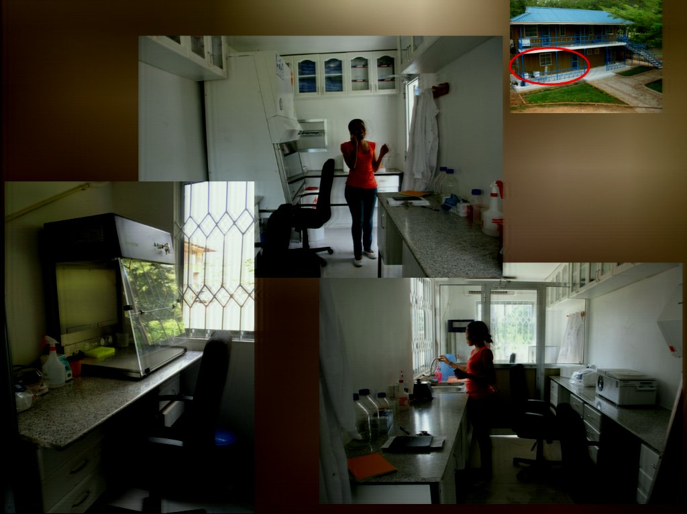
Notes:
This is a brand new molecular laboratory in Tanzania at Sokoine University of Agriculture that we helped to build. You would never actually know that, but this is -- these are two shipping containers that have been put on top of each other, and then inside we outfitted it with complete molecular lab by a safety cabinet level two, PCR workstation, new PCR machines. So for a very small amount of money we were able to build capacity in a really easy way in this country.
Biological Science
PREDICT

Slide 18
Notes:
So I'm going to now go through and talk about the different parts of the project and show you a little bit about how we're actually trying to implement it. And the first thing was to try to understand what is the baseline capacity in these countries? Both sort of from a personnel side of things as well as from an infrastructure side of things. And so what this entails is we developed a survey that then required our team to go out and actually talk to the people living in those communities, and try to understand what the issues were. And this is our team sitting just outside Ruaha National Park in Tanzania.
Biological Science
PREDICT

Slide 19
Notes:
And again, remember the goal is to develop a wildlife surveillance arm for this global system so that we can detect diseases in wildlife before they jump into people. And we're very cognizant of the fact that our job is to really bolster the wildlife aspect of it; it's our expertise. But also that other organizations, international organizations like FAO and WHO and OIE that are working on the other parts, and so we're working together with those other organizations.
Biological Science
PREDICT

Slide 20
Notes:
So the first thing we did as part of the capacity session is we asked our team leaders in each country to develop a map of where they think these high risk areas are, as well as where there's infrastructure in these countries, so that we could understand, first of all, what are our challenges? Where are the places that we need to be working versus where the place is we can actually get samples to a lab and get any testing done.
Biological Science
PREDICT

Slide 21
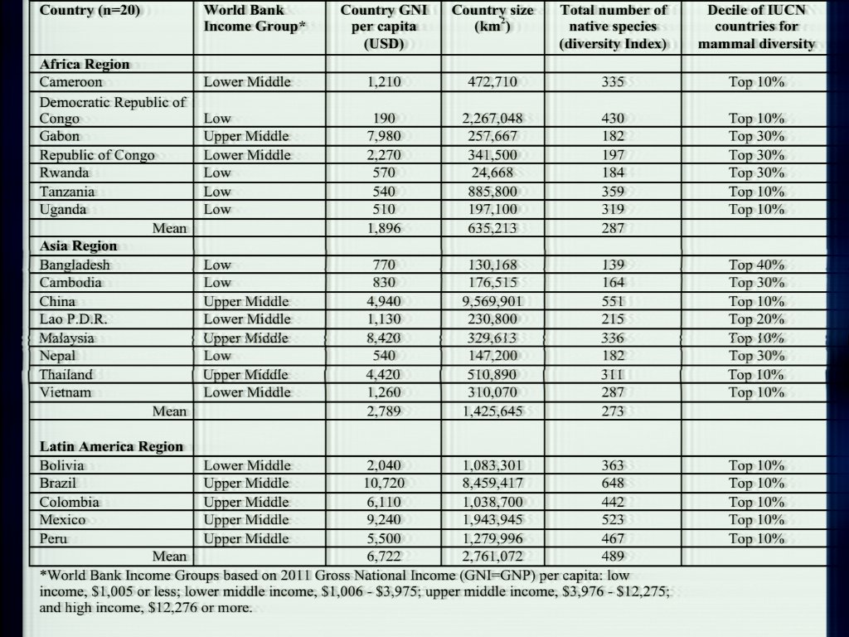
Notes:
And then we also wanted to sort of get an idea for sort of the country's capacity based on sort of the global scale in terms of like GDP. So, you know, not just the capacity to do the work but that they have the ability for support by their governments or of other governments to even help to do that work. So, we took all of our regions and we looked at them and we looked at sort of their GDA -- GDI, and we looked at the species diversity, and then we tried to see if we could somehow rank their capacity, based on some of these other factors that we might be able to help us to determine where we should actually put our investments in these countries
Biological Science
PREDICT

Slide 22
Notes:
And we also started to ask questions about -- okay, so tell us about what you think the capacity is to go out and do surveillance in wildlife animals, compared to domestic animals, and compared to humans. And, I think, you can probably see a pretty consistent trend where we pretty much found there was almost limited ability to do any type of wildlife sampling or wildlife surveillance. Usually some were for domestic animals and, depending on the countries and the regions, you would find more than others; and then, of course, the most in humans. And what we also interestingly found, which [inaudible] a bit interesting is that, in Latin America we found that there was the most capacity. And it's, you know, they have a much shorter timeline from colonization to independence, and so I think that sort of makes sense in some of these countries to explain why maybe they have had the ability to move forward on some of these activities.
Biological Science
PREDICT

Slide 23
Notes:
We also asked them, you know, what did they think were the challenges to doing surveillance in the country, to try to get a feeling for, you know, again, how would we choose, pick and choose, how we're going to do our investments and where we're going to work.
Biological Science
PREDICT

Slide 24
Notes:
And similarly, we asked them, you know, if you had funding, what are the opportunities to try to improve wildlife surveillance and public health in your country? So this is really -- this was the result of sort of years one and two. And we're now using it to help to refocus our work in every country as we move forward with the project.
Biological Science
PREDICT

Slide 25
Notes:
So, one of the biggest challenges right off the bat was capacity building. There was almost no infrastructure in some of these places to do the work. So, for example, like I said, in Tanzania we had to build the first molecular lab that was available to do wildlife samples. Additionally, cold chain, we're mostly dealing with RNA viruses which I'll show in a little bit, and those -- they're just not that stable. So we needed to be able to have a way that we could collect samples in the field and actually keep them cold enough, to get them into a lab, to where they would then be a useful sample for actual testing. And what we ended up having to do, which is what you're looking at here, is in some places we had to put in a liquid nitrogen generator so that they actually had the ability to keep things cold. In this part of Tanzania power is like completely not consistent, in part because of this water issue. So putting minus 80 freezers out there made no sense; so we had to find some other ways to keep samples cool. And we've actually become quite popular. We're now supporting the local hospital, the local ministries, and everybody because nobody else had cold chain either, and they're actually quite excited to have this. We also put this in place in DRC and -- what was the third -- oh, and in Rwanda we had to put in a liquid nitrogen generator, as well.
Biological Science
PREDICT

Slide 26
Notes:
And then, of course, personnel training. We've invested immensely on training veterinarians to go out into the field and sample animals; training ministry officials and biologists to come out and learn how to do that themselves. In Indonesia now, they're doing it without us, which is great. And then in the lab to do the diagnostic testing.
Biological Science
PREDICT

Slide 27
Notes:
And, of course, we had to build new partnerships; we had to find new labs to collaborate with. So it's been -- the first couple of years was really a big effort just to get the project off the ground. But now, finally, we're in that part of actually sampling and collecting data.
Biological Science
PREDICT

Slide 28
Notes:
So, as I said, a lot of huge challenges just getting the project started. You know, working with different cultures -- everybody has different ideas of timelines, and deadlines, and deliverables. So it's been really fun trying to learn to see what motivates people in different countries. Supply chains has been a huge problem -- trying to convince these huge companies like InvivoGen, and Qiagen, and Fisher and everybody else that there is a need and that there's always been a need and that, you know, they need to sort of improve their supply chains. It's just been crazy and very frustrating. These labs wait for six months, sometimes longer, for reagents to arrive, which by then have been thawed by the time they get there. So that's been a big challenge with us is trying to work with these European and American companies to understand the importance of this work.
Biological Science
PREDICT

Slide 29
Notes:
And then Skype. I can't even tell you how much I love -- I guess maybe, spend on Skype, as we all do. It's amazing. It's a way for us to connect with these folks around the world. My lab technician helps to calibrate machines in Tanzania over Skype. So he gets on the video; they show him the machine; and they talk through it. And so, this is something that we've really done a lot because it's really hard to always just jump on a plane and get to these countries. So, we do a lot of phone and Skype meetings to try to troubleshoot and work through problems on a daily basis.
Biological Science
PREDICT

Slide 30
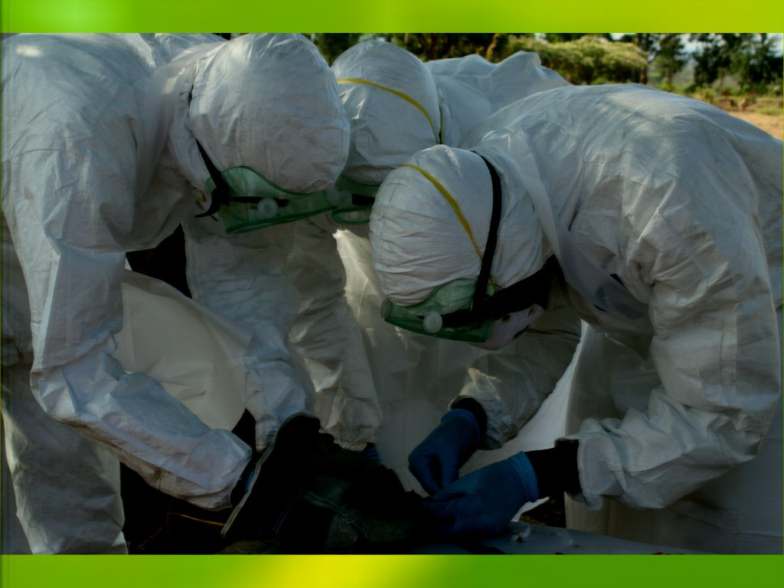
Notes:
And then, of course, training. For most of those folks, they've never really worked with these types of animals. They've never really had to deal with PPE keeping them safe or actually even working with, in some situations, the health departments who go in and do pest control. And they never thought to wear gloves or masks as they're collecting and killing rodents because it didn't even dawn on them that they may get diseases from these animals. So we're hoping we're having a much bigger effect than just with our local teams on the ground.
Biological Science
PREDICT

Slide 31
Notes:
So when it comes to our surveillance we are, again, trying to target these places where animals and people are coming in close contact. So in many places we are working in areas where there's huge land use change. We actually have a project in Uganda, and Malaysia, and Brazil, where we have sampling sites across this land use change gradient and we're trying to understand is there a difference in animal diversity and also pathogen diversity as you move from a pristine site in a forest, all the way to a disturbed site in a building and then along that way where there's agriculture, both crossing animals. But I think, again, for those of you who may have seen “Contagion,” one of the really big places that we know -- and this is a potential for viruses to jump -- is when people go into the forest, they log roads, they cut down trees, they go into caves. And suddenly you have species that are coming in contact that have never come in contact before and they have their own viruses, we have our own viruses, and when they have the ability to jump over, they have the ability to make both animals and people really sick.
Biological Science
PREDICT

Slide 32
Notes:
In many places there's a lot of subsistence hunting in villages. This is -- this happens to be in Asia, but obviously this occurs a lot in Africa, as well. So people come hunting animals, butchering animals, often not with gloves, sometimes eating them raw, sometimes not eating them raw; so a lot of, again, opportunity for pathogens to jump. And this is the idea is how people -- how HIV first jumped from chimpanzees into people.
Biological Science
PREDICT

Slide 33
Notes:
And again, in markets. In some cases, you know, the hunters will get the animals out in these remote locations and then just keep them at home and just, you know, eat them, you know, within their local communities and families. But in some cases they actually come to the cities and they bring them to markets, they're sold at restaurants, people take them home; and this is also another opportunity for pathogens to jump really quickly. Also, in live markets you have multiple species together in multiple places and right now in China -- some of you might have read, of course, about the recent flu outbreak. And it's a huge challenge in these live markets, and they're trying to determine can they close the markets, can they control animals coming into the markets, what species -- because that's the place, where viruses are able to jump.
Biological Science
PREDICT

Slide 34
Notes:
And, of course, the extractive industries. In Africa in particular, there's a lot right now of people going into mines or going into caves, to develop new mines, as well as looking for oil, and other natural gases. So all of a sudden, a lot of new areas where people are brought in from other countries, cutting down -- I mean cutting down trees, building new roads, and then basically living in these places. Pretty little infrastructure surrounded by wildlife.
Biological Science
PREDICT

Slide 35
Notes:
So to date, we -- this is actually -- these are slightly old numbers. We've actually sampled more than 40,000 animals in 20 countries. And we're really trying, as you can see from the group's interfaces, to really target these high-risk areas of where the animals might be coming from. We are, of course, going into pristine areas and also sampling free-ranging and very healthy animals, so we have some control or comparison data for these places where animals and humans are in high contact.
Biological Science
PREDICT

Slide 36
Notes:
And then when it comes to taxonomic groups, we are primarily focusing on primates, bats, and rodents. And there's a few reasons for this. Either, because of in the case of primates, we are closely related to them so, you know, a virus that can live in people can likely live in primates; not all of them, but many of them can. And then bats and rodents because we live in really, really close contact with them. In this country maybe not so much but in places like, again in Katmandu, they were just trapping in people's homes and catching rodents every single day. And when you go and chat with these people, they tell you every day about how they got bitten or their child got bitten or the rodent was running across the table and ate some of their food. So, clearly, in really, really close contact with animals.
Biological Science
PREDICT

Slide 37
Notes:
And then, of course, bats. In parts of Asia especially, where fruit bats are hanging over areas where it's common for people to go get water, we're finding shared pathogens in fruit bats and water and in cows and people, so we're seeing that there is this sharing of these resources, and then contact.
Biological Science
PREDICT

Slide 38
Notes:
And this is really supposed to be a rodent photo, not a bird. There really are rodents here in this cage there in the middle of the market. And so we are, when needed, focusing on birds and other species. Of course, right now, with the influenza outbreak, we're helping to work with surveyors on wild birds and also poultry. But really, our main, main focus, unless there's a good reason for it, are those three taxonomic groups that I mentioned.
Biological Science
PREDICT

Slide 39
Notes:
And again, to date, you can kind of see that our strategy is really focused on these three taxas, so this is really where we've been working.
Biological Science
PREDICT

Slide 40
Notes:
And then we are doing human surveillance. Initially we were just doing it in China and Indonesia and Malaysia. We're now expanding to Uganda and Rwanda. So the idea here is that we're actually not just sampling the wildlife but we're actually sampling the people that are living in that area so that we can really do a better job to document shared pathogens between people and animals. And in many places we're working really closely with places like the CDC or AFRAMS or Ditro [assumed spelling] or other -- some of those other organizations that have historically done human-related work.
Biological Science
PREDICT

Slide 41
Notes:
So then when it came to our testing, we really had to think about how do we change the way testing is being done to be able to detect the known pathogens but also the new ones. And we realized that we had to bring in a new paradigm that could actually be put in place in these really resource-constrained places.
Biological Science
PREDICT

Slide 42
Notes:
And so we kind of almost went -- in some situations we almost went backwards to something called consensus PCR, which I'll talk about in just a second. But the traditional method right now in most labs, including in this country, if you were sick, you went into a doctor. They would do the first test based on what they thought you might have, and if that comes up negative, they'll go down the next list of potentially maybe eight different tests and, if you're lucky, one of those will come up positive and they'll figure out what you have. In many cases those don't come up positive and they don't know what your disease is. So our idea was to sort of do this more broad, older kind of method that has been used for many years in research labs but not yet, sort of, in the diagnostic arena -- where you go back to what's called degenerate or consensus primers where -- that allows you to identify near neighbors. So instead of testing for herpes viruses, or a specific herpes -- say Herpes-B, you're looking for all herpes viruses. So that will allow you to detect known and new things.
Biological Science
PREDICT

Slide 43
Notes:
And so this kind of gives you an example where you use these primers that can detect things of -- that are kind of similar but not identical. And this is what we call conventional PCR and many of you probably have done that. And the thing about that that made it so -- something that we wanted to do was that these days with -- especially off the avian influenza -- most of these labs around the world had real-time PCR machines, and that is what all of their protocols were now doing. And they had these old conventional PCR machines sitting in the corner that nobody was using. So it was our way to actually use this equipment that nobody was using anymore and allow the labs to expand their capacity.
Biological Science
PREDICT

Slide 44
Notes:
And so what it allows you to do is you do sort of broad screening and then you follow up with sequencing. So you get really, really high detailed level information about what the actual pathogen is. And the way we're doing it: again, we had to target the types of viral families that we were going to test for. We couldn't test for everything. And so we really are focusing for the most part on those RNA viruses, those viruses that jump species; so Phenaviruses [assumed spelling] that in that family are things like Ebola; paramyxoviruses that carry things like nipah virus or measles. And the idea behind that is that we can be sort of on the edge looking for these new viruses. And we are also -- we developed sort of a priority list depending on what species we were testing so that, again, we could get some consistent data. It's too many protocols for any one lab to take on all at once, so this is a way for us to sort of focus the work.
Biological Science
PREDICT

Slide 45
Notes:
And one of the biggest challenges actually was getting positive control material out to these labs to work with. It's not a simple thing to sort of put Ebola in a tube and ship it around the world to 20 labs. This is probably not going to happen. And so we had to come up with a new way to do this; and we came up with what we call universal control one -- we actually just made a second one --which is a synthetic construct. So, basically, we put the primers for each of the protocols in this synthetic construct and that we can grow easily in bacteria and make up as much of it as we want and ship it easily around the world, and it's not infectious. So in the end, that was our solution to getting control material out to the labs.
Biological Science
PREDICT

Slide 46
Notes:
So, our goal, I guess, is to put ourselves out of business. We want all this work as much as possible to happen in the country or in the region. So we're currently working with 33 labs around the world, and we're working to train them to do the testing there. And this is sort of a combination of folks coming to my lab or coming to a partner's lab in New York, or sending our technicians out to their labs. Our post doctors spend six weeks in Laos and in Vietnam working with the technicians and teaching them to train. So in the last two years this has been of huge focus and we're really -- actually, these numbers should be updated. We actually have 27 labs now that are doing at least one or more of our viral family protocols, and then additional ones that are learning. And we've also developed sort of this regional support. So in Tanzania and Rwanda the labs there had much less capacity and much less experience ever doing this type of work. And so the lab in Uganda actually was quite experienced, so we're shipping samples from Rwanda and Tanzania to Uganda for testing as they're building the capacity. And we're doing a similar thing in Southeast Asia with Cambodia and Laos. So it's the way to hopefully build better collaborations among the countries, as well as a way for them to get the work done without always having to come to the U.S. or Europe which is what always has been the standard in the past.
Biological Science
PREDICT

Slide 47
Notes:
And recently, just sort of an example to show you how this has been working, we tested three species of primates in Rwanda, so two types of mountain gorillas and golden monkeys. And these were animals that were either in low contact with people, so golden monkeys in the forest, all the way to orphaned gorillas that were living in really close contact with people in sanctuaries and being raised by people. And we tested them for 17 different viral families. And of those, we found 15 viruses in 19 animals. Seven of them were known, and many of them actually -- although they were known -- we found them in new species that they never had been documented in before. And then, eight of them were new. And of those eight that were new, four of them, actually, were closely related to human viruses; so they were in families like enteroviruses or adenoviruses that we know have the potential to jump across species.
And so, this sort of did a couple of things. First, I think, you know, sort of from the wildlife biologist's side of it, we're interested in trying to understand better what are the pathogens that these animals can carry or maybe not even pathogens, but what are the viruses that these animals can carry? So we -- at the end of this, we'll have a new global map of, you know, baseline viruses that these species have. But then also find which ones can be shared by multiple species. And then, actually, probably the biggest thing was it's helping us to target. You know we can't characterize 19 viruses every time we find a new virus. But focusing on four that look to be related to people -- that might be something that's slightly more do-able. And that's where we're working through our algorithms to try to figure out how do we take, you know, some of these ones that appear to have important factors that might be important for jumping and further characterize them and understand them better.
Biological Science
PREDICT

Slide 48
Notes:
Surprisingly, we found also -- there is actually a cost savings to our strategy, which really surprised us. And what we realize is when you do the routine testing which is, you know, you rule out about eight different pathogens and then you still had -- don't have an answer. Now maybe you have to ship something to the U.S. for something like sequencing or some sort of further analysis. Sometimes that can cost up to around $3500 per sample. And what we found with ours was that although we had some initial expenses in extraction and preparing of the sample for testing, once we had that expected sample, we could actually pretty cheaply do multiple PCR reactions on it. And so, our cost is around $300 per sample, even when you have a positive that you need to follow up and figure out what it is. And so when you expand this globally to a hundred thousand samples, instead of being in the hundreds of millions where we would have been with the original -- the routine testing scheme, we're sort of in the hundreds of thousands. And so, while still expensive, we've definitely decreased the cost, and hopefully have a much more specific way to actually diagnose diseases.
Biological Science
PREDICT

Slide 49
Notes:
Of course, challenges are always in sustaining that capacity in those labs. Labs get busy. Right now I can tell you our partner labs in China are not doing any of our testing because they're all testing for influenza. So there's always those issues and having to balance the needs of the country and the project. And then training -- a large turnover. A lot of these folks, you know, get a little bit of training and then that's enough for them to come to the U.S. or go abroad to Australia and get into universities. And so it's a constant sort of turnover in trying to keep the folks in the labs trained and available to do the testing. And then resources -- I already talked about that in a little -- you know, earlier. Just to say how difficult it is with the companies.
Biological Science
PREDICT

Slide 50
Notes:
But really the idea is we have really, hopefully, given these countries inexpensive diagnostic tools that they can increase their capacity in the country. And hopefully, you know, over time, this will be a step-wise way to increase the improvement of pandemic prevention.
Biological Science
PREDICT

Slide 51
Notes:
We do, also, when needed -- you know, our methods are great but they don't find everything and there are times when even we've exhausted -- we've gone down our whole list of viral families and still can't find out why this person's sick.
Biological Science
PREDICT

Slide 52
Notes:
And in that situation we will often go to more advanced methods such as deep sequencing. You've probably heard things like deep sequencing, Illumina, HiSeq, MiSeq. These are all different ways that are sort of a shotgun approach to try to amplify everything in that sample in the hopes that you can identify the genome of something that was not identifiable. And we're doing those in a few labs. We do have some capacity in Cambodia and in Singapore and a couple of other places. But this is really both expensive equipment, as well as it takes teams of bio-technicians to actually go through the data that comes out of that, and that's just not really realistic on a global scale, nor is it realistic in terms of human resources, you know. It's a huge amount of effort to train folks to be able to do this, and we found in some places a partner actually did that up in Cameroon and they've actually stopped because they've realized that although those people were well-trained, they've now moved on to other jobs and now they have no capacity again to do that. And so, we've really -- are only focusing this sort of method for the situations where we really feel it's needed.
Biological Science
PREDICT

Slide 53
Notes:
But there are some times when it's actually been quite useful. So, recently, in Congo -- and this was done in collaboration with SUMF which is in Gabon and then also U.C. San Francisco. There was an unknown hemorrhagic outbreak in people, and finally they were able to collect serum samples from some of them, and they were negative for everything that they tested them for.
Biological Science
PREDICT

Slide 54
Notes:
And they went through and they looked at people and disease onset and all the usual steps that you might do during an outbreak, and they could not find a consistent disease that made sense in terms of what was causing the death in these animals -- I mean, in these people.
Biological Science
PREDICT

Slide 55
Notes:
And they finally did deep sequencing. And what they found was a brand new rhabdovirus virus. So rhabdoviruses of a family that have rabies, and you know, there's not a lot of rhabdoviruses known. Rabies is one of the ones that -- the most common one in that family, and there's very few others. And so they were very, very surprised to find this brand new rhabdovirus. And our protocols looking back may have been able to detect those, but those had not yet been deployed yet in that country. So had we just done the routine testing, and most rabies virus tests that are out there would never have detected this. So it was an amazing opportunity to be able to do this.
Biological Science
PREDICT

Slide 56
Notes:
And we then went back and we -- after having detected what this virus was, we could then use that to develop a serologic test, and went back and could do testing to look at the people that had come in contact with those who had died and those in their family, and actually go back and document that there really was an exposure event and people really did get exposed to that virus. And then that -- it actually kind of fills it out pretty quickly. As you can see the contacts in red were those who were in close contact with the person who got sick and died. But when we went beyond those and tested people who had been in contact with the contacts, we found that those were the people who had not been exposed. So, luckily, this is an example where a virus was able to jump potentially from a vector or from an animal into people, and although it did have, you know, severe consequences for a small group in a village, it wasn't able to jump outside beyond that. And the group in San Francisco is now looking and trying to understand why -- what was it about this virus that didn't make it something that was potentially pandemic. It seemed like it had all of the characteristics, right? It could jump from multiple species; it could go from person to person; it made people sick; it made people die. But why did it not go further? And that's what they're focusing on trying to understand right now.
Biological Science
PREDICT

Slide 57
Notes:
And then as a part of this project and not necessarily even on purpose, we found ourselves either a part of or assisting with outbreak response. And in some countries we've actually now become part of the national task force, which is amazing and a huge step. So, prior to -- the first time there was an outbreak in Uganda, and this is a map showing you an outbreak of -- actually it turned out to be yellow fever -- all the way up here on the Sudan/Uganda border. It was very disjointed. In Uganda the way it works is until there's a reason or identification of the outbreak, no funds can actually flow to help to support that outbreak response. Which is really bizarre, right? Because once you know what the cause of the outbreak is and then it's much easier to respond, but you need those resources to try to figure out what the outbreak was. And what we found was it was very disjointed. We heard reports in these remote areas of people dying and nobody knew who to go out and respond. Nobody could get money to flow. Nobody could get kits that, you know, to bring gloves and gowns and syringes to go out in the field to do that. The first time a group of people went out to see if they could get to the village, the road ended and they turned around and came home. Our team actually went up and actually had to hike out beyond the end of the road because we knew that there were actually people beyond that. And so it sort of highlighted the situation of people just not really having to work in that sort of environment, and realizing that, of course, things happen in remote locations and that you need some people experienced working in that remote location.
Biological Science
PREDICT

Slide 58
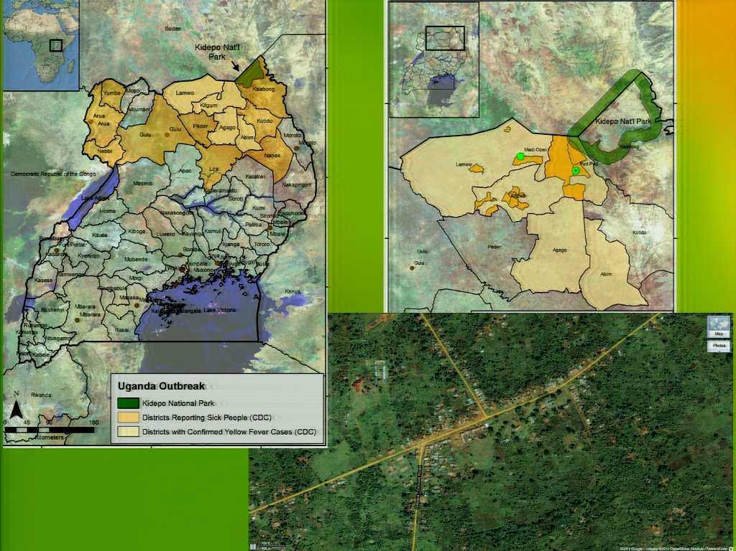
Notes:
The sad thing about this outbreak was, first of all, it went on for about three months before the disease was identified. And then when it was finally identified it was yellow fever -- something that's actually endemic in Africa. And, unfortunately, because it had been so long since it had been seen, the diagnostic tests were no longer available in the country and so there was no ability to do that, and it took a while to get the samples. Eventually it got shipped to the U.S. and the diagnosis was made. So that's the one place that we now are heavily involved in, and Uganda is being a part of the national task force, offering up our diagnostics as well as our field expertise to go out to these remote locations and do the sampling.
Biological Science
PREDICT

Slide 59
Notes:
We also, when we go out during these outbreaks, we've now developed what we call a human/animal contact survey. So we go out and we talk to the people in the villages about who they've come in contact with, what types of animals, what they eat, have they been bitten, what animals come into their fields, what kinds of animals they have. So we can start to get an idea of how this contact is happening and some of you may have heard recently, in the last two years there's been a couple of Ebola outbreaks in Uganda. And we actually deployed this in the last outbreak because the question still is, is what is the reservoir for Ebola in Africa? Nobody really knows. There's some suggestion of it being in bats, but nobody's really gone out there and done consistent surveys and consistent animal testing to try to understand. And that's one of the things that we're focusing on in PREDICT.
Biological Science
PREDICT

Slide 60
Notes:
So this was the recent outbreak in Uganda where you may have heard that there was Ebola. So then in July -- and with the -- the first time there was an outbreak it was -- as I said, there were months before the first outbreak -- I mean, before the first case was detected. In this case, although still quite long, within three weeks, the first case was detected and reported, and because of the previous outbreaks some of these diagnostics had been re-implemented in the local human/animal laboratory in Kampala, and they were able to confirm the first human cases within the first month of the outbreak. So this really demonstrated a huge improvement on the previous system.
Biological Science
PREDICT

Slide 61
Notes:
And so, again, PREDICT's assistance during these outbreaks as we go out and we surveil -- we do sampling of wildlife and also, domestic animals in the areas around where the people have been sick or dying. And we also do these surveys to talk with the folks about who they're coming in contact, what animals, and then we bring that information back. These groups are coordinated by the Ministry of Health. So we bring them information back to the Ministry, and then they determine how to follow up. And now, it should have become standard. PREDICT is now a part of these outbreak investigations. We are the ecological arm for that. And whenever there's an outbreak, rather than [noise] waiting months to weeks for us to be invited to the table, we're called right away and we're a part of this organization. So we feel like that is definitely one place that we've had a huge success in the country.
Biological Science
PREDICT

Slide 62
Notes:
We've now, since that time, been involved in multiple Ebola outbreaks in Uganda and also in DRC, and we've been involved all the way from just providing gloves and masks when people are going out in the field -- all the way to actually collecting samples from animals, and doing surveys, and then providing results back to the government.
Biological Science
PREDICT

Slide 63
Notes:
And so I think the important point before I finish up on this is we really are there at the sort of invitation of the government. And while we know that this is a global health project and we want to share our results with the global public health community, we really have to make sure that we give our results and get approval for release of these data from the host country governments first. And so there are pretty strict policies in place that we report to them. They have a period of time that they can actually then come back to us with questions, and then finally approval. Once that is approved, we release those data to the public on HealthMap, which is -- it's a public site that anybody can access, as well as in scientific publications and then all of the sequences eventually, after being published, go onto GenBank. So that's sort of the strategy that we have.
But we're pretty cognizant of the fact that if we do anything to upset the host country government, that pretty much ends our ability to work in that country. So we do provide data. Recently, when there was that new bat coronavirus in Qatar, we weren't able to share our data but we were able to take the sequence from those bat viruses, compare them to what we were -- what we had, and then provide the government with some information about, did it appear to be a bat virus, was it related, was it new, had we seen it before? So we definitely assist in these global outbreak investigations, even when we aren't able to provide the raw data.
Biological Science
PREDICT

Slide 64
Notes:
So, some of the successes -- we're in our fourth year of a five-year project, and we actually -- I been quite lucky to have quite a few success, and I think it's because we've had these teams on the ground before the project started, and that allowed us to keep going really quickly. But [clicker sound] we've been able to detect new and undiagnosed diseases in pretty much any resource setting. So, we work with some pretty fancy labs in China all the way to that little lab that I showed you that we had developed in Tanzania. This number of trained personnel has actually gone up. We've trained probably now more than 2,000 field biologists, veterinarians, lab technicians, and then mostly importantly, probably public health workers within the ministries. And that's the way, really, that this project is going to have sustained life because if the ministries can continue to do the work without us, then this type of work will continue. And then, like I already showed you with that one slide, we're building the capacity to test for viral families in 33 labs in 20 countries, which keeps us pretty busy on the most part.
We have sampled more than actually 40,000 animals and we've discovered more than 200 new viruses, and these are sometimes from important families including coronaviruses, adenoviruses, herpes viruses, and rhabdoviruses. And then of those, probably between 10 to 20% appear to have [noise] origin from other species, not always human. Sometimes we find what look like cow viruses in bats or rodent viruses in bats, and so those are the ones that we're now hoping to target, characterizing, and better understanding. And then we have documented human pathogens in wildlife, so we've documented [noise] some human herpes viruses in these gorillas that live closely with people, but then also the other way around. We've also documented animal-origin pathogens in humans. So it looks like our strategies are working. We're excited to see what the next year and a half is going to bring.
Biological Science
PREDICT

Slide 65
Notes:
And with that, I'm happy to take some questions.
Dr. Goldstein: Yes.
Audience member: Okay. I don't [inaudible] they tried to [inaudible] to or [inaudible] tell us about [inaudible].
Dr. Goldstein: Probably, I guess maybe two. One that - it was actually a known endemic virus, that -- there was at that time no capacity to test for. So really we spent thousands of dollars to test for something that should have just been a routine test that was available in the country. And then the second was just that at that time, I think, also probably and part of why we were not able to do the diagnosis, the emergency response was so disjointed. There was nobody leading the effort, and so, I think, without that coordination it made detection and diagnosis just that much longer and slower. Yes?
Audience member: I remember taking -- a class that I'm taking right now. We went over a little bit of how the training mission of the pathogen can affect its base ability to be a pathogen...
Dr. Goldstein: Yeah.
Audience member: ...and so [inaudible] a pathogen [inaudible] you had to be inside looking into the pathogen with regards to that, would you remain [inaudible].
Biological Science
PREDICT

Slide 66
Notes:
Dr. Goldstein: Yeah, so, you know that's a really good question and the thing we struggle with all the time. So, obviously the first sort of initial look is based on biogenetics. And also we look at a host's genes that we found in those samples as well. And then the next step is to put them on different cell lines and, you know, animal and human cell lines and look at their permissibility on those. And then we're also starting to -- we can't do every virus but looking at receptors in the human cells, animal cells. So that's sort of the big part of the project that we actually aren't funded by USAID to do. And so, that's a little bit where things sort of fall down. And so, if we're able to get funding in this next round to continue on this project, our hope is to bring other organizations like NIH into the project so that when we do find these things, there's an easy way to then hand off that particular pathogen, both to facilities that have laboratories that are safe enough [screeching sound] to handle them, and then second of all, that can do [screeching sound] this for the characterizations. It's clearly really important. So we're doing it on a small scale right now but not broadly and it needs to increase for sure, yeah. Yeah.
Audience member: [Inaudible] these virus transmission, they're very localized for some [inaudible] over the large [inaudible] and lots of bats have been in the areas [inaudible].
Biological Science
PREDICT

Slide 67
Notes:
Dr. Goldstein: Good question. I think there's a lot of different things, right? So, some viruses might be more transmissible but the way they're transmitted is maybe through blood. And so if you don't have a lot of hunters that are coming in contact with blood, that might not be able to grow -- you know, go further. But if you have a virus, it's actually easily transmissible and can be transmitted by aerosol or by direct contact. Then that's a virus that potentially could spread much further. So I think it's a combination of both the virus' factors itself, as well as how transmission can occur, and then the environment that might affect it all. So, all of those things. I think there's another -- yes.
Audience member: I heard you mentioned a lot about this stuff, but when you get into those countries like -- what organizations do you make [inaudible] the project [inaudible]?
Dr. Goldstein: Yeah. It's a good question. So the -- it's a little bit different in every country, but we've tried to really hard have teams that are from the country and used to work there. So, for example, in Uganda, our country [screeching sound] lead used to be a veterinarian for the Wildlife Department, so he was really, really well connected and knew all the ministry officials already. Usually, in many of these countries, we're well connected within the wildlife sector. But not always as well connected in animal or human, and so that's been the big job for our country leads for the last few years, is to figure out who in the ministries are important and who needs to be informed on this information. And in big countries like Tanzania that's usually hard.
Biological Science
PREDICT

Slide 68
Notes:
In Nepal it turns out it's really small and everybody knows each other, so it's much easier to bring them all to the table and get them on board. But I think the key really has been that we -- rather than having me go into the country and try to figure out how to do it, we're hiring people from those countries so they're usually more connected. Yeah?
Audience member: Another question. What [inaudible]. Is there a risk that you could get a lot involved in the [inaudible] if the [inaudible]?
Dr. Goldstein: Yeah, so the sequencing itself is very sensitive. However, the PCR, as you say, is not always. And so exactly that. So you get a combination of -- if you don't have a high enough viral load, you may not detect it. So, of course, we might miss some things. But also because it's degenerate, you will pick up a lot of sort of nonsense, basically, in the system. So you can't assume that just because you've got something that looks to be PCR positive, is actually positive. But once you actually have a positive, the data that you get is actually of really high, high quality. Yep. But certainly that is definitely a problem. And it's kind of retraining folks because they see a positive and they go and get all excited and they assume it's going to be a virus, and so it's -- that sort of work of retraining people to realize that until you have confirmatory testing you can't assume that that virus is really there or real, so...
Audience member: But you test it with blood?
Biological Science
PREDICT

Slide 69
Notes:
Dr. Goldstein: Some. So the problem with antibody testing is -- there's not a lot of reagents available for some of these things, and if you test for something that's related, you just get cross re-activities, so you don't really know is it Ebola or is it something different? And it -- also when you're working in wildlife, even if there might be reagents in people, there's almost never reagents that work in wildlife species. So we're targeting in it. So with that rabies, that new rabies scenario, we did develop a serologic test just for that. But, unfortunately, there's just not a broad-scale serologic test that we can use for many of these potential pathogens. But that's where the NIH hopefully comes in again. [Laughter] So -- nobody else? If there's no other questions. [Inaudible] .Thanks for listening [applause].
Biological Science
PREDICT

